Slide 1
AAE03a - Autonomous Landing of UAV on Mobile Platform
LEUNG, Cheuk Hei (Hubert)
WAN, Chun Yan (Gorby)
YUEN, Wai Ki (Ricky)

Slide 2
What are we going to do…
Cam attached under the UAV
Aruco Code*2 (BIG and small) on the moving platform
UAV in air; Platform moves on ground
Hold and Search for the target (BIG)
Cam capture the BIG one and UAV Follows it
Descend and Switch to follow the small once too close
Land (well, if we manage)

Slide 3
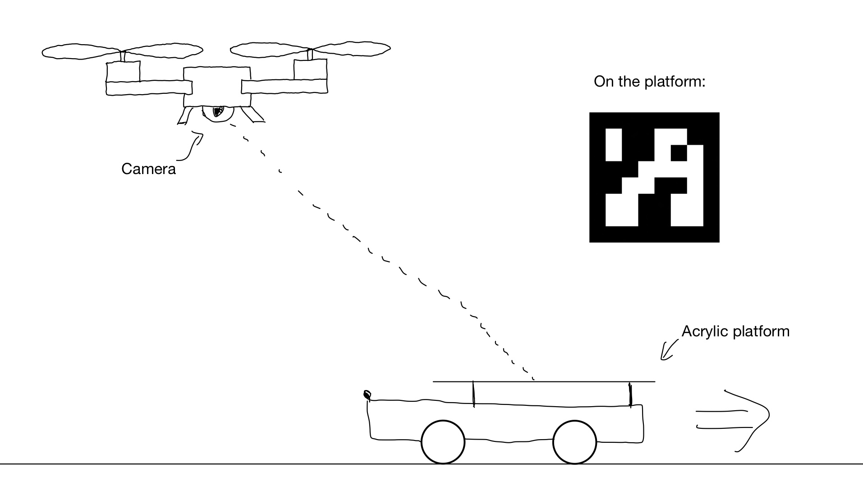
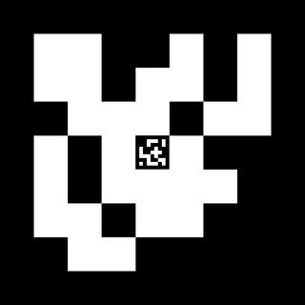

Slide 4
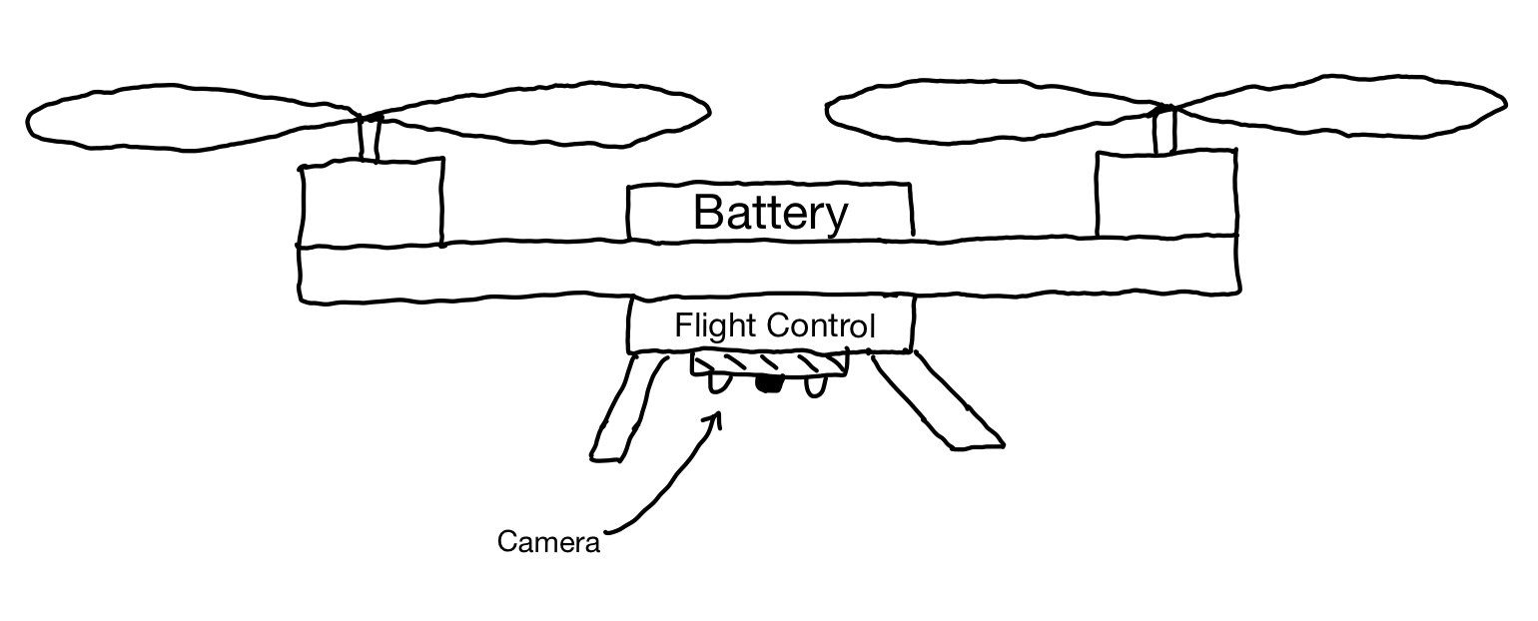
Body Structure of UAV

Slide 5
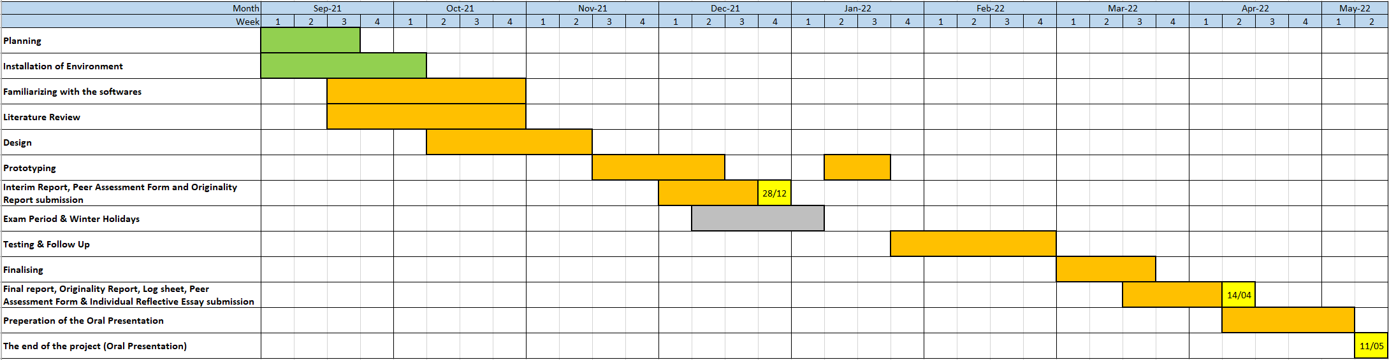
Gannt Chart

Slide 6
ROS (Robot Operation System)
Flight control system
Message passing between control interface and output unit
Remote Procedures Calls
Localization, Mapping, Navigation
Two of us (Hubert & Gorby) are going to study this part
Fortunately we may familiarize with it in coming few weeks ^_^

Slide 7
PX4 Autopilot
provided by the flight stack
flight modes and safety features
Support precision landing on moving targets
Two of us (Hubert & Gorby) are going to study this part
Fortunately, we may familiarize with it after the ROS

Slide 8
Open CV
Use to recognise the Aruco code
Ricky is going to take care of this part for now
My laptop doesn’t have a cam onboard so I will probably buy a webcam instead to test out the codes and try my hands on the toolkit

Slide 9
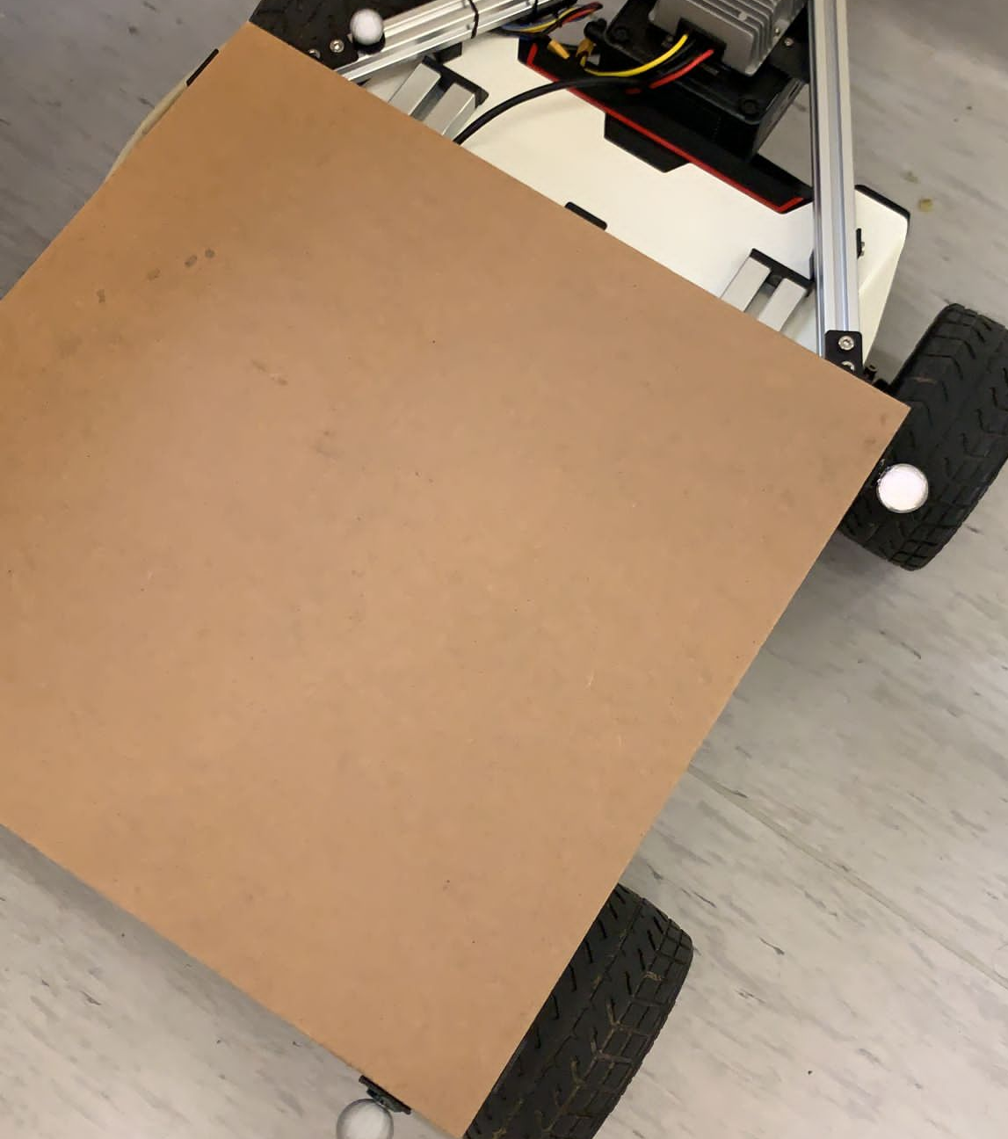
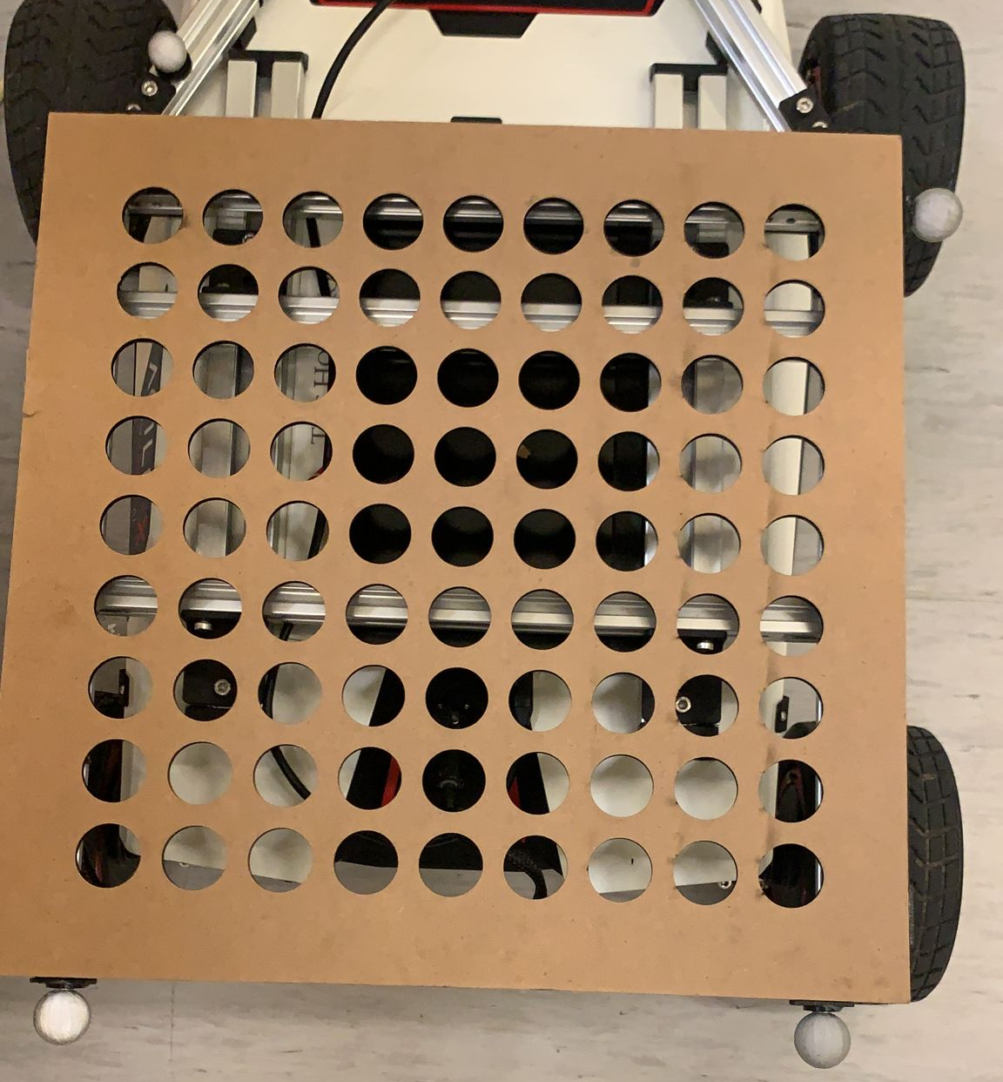
The Platform (as for now)
IC Laser Cutting
*We made two transparent acrylic board too in order to hold the Aruco Code in-between should a change of code is needed but there is no hole yet.

Slide 10
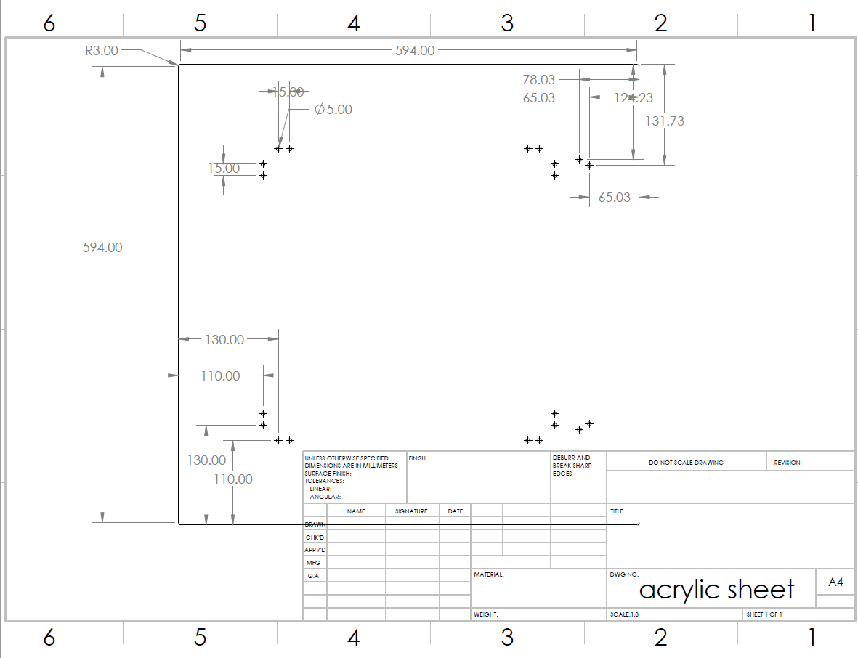

Slide 11
Notes
Story and application
Prove (studies)
System and sub-system
How they are divided
Keep record to what we are doing (discussion? Work? )

